Slide 1

Games Research & Development Block 03 – Week 05

Slide 2

THIS WEEK
Video / Demo
One-on-One Meetings

Slide 3
NEXT WEEK
Playtest with the 2nd years
Play & Games
FINAL MILESTONE REVIEW

Slide 4

Final Milestone Review
10-15 minutes (ish) Presentation
Demo of what implemented
“Demo” of testing procedure
Preliminary Conclusions
Structure of write up for “Journal”

Slide 5
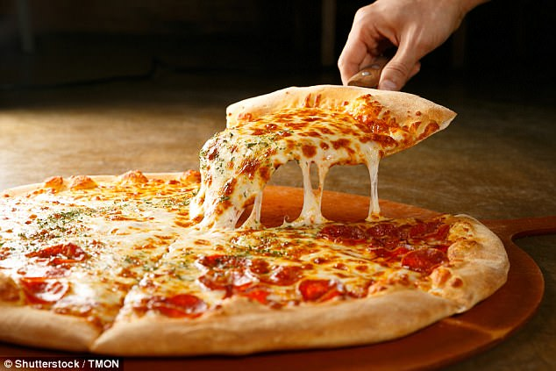
PIZZA PLAY TEST
Coming up: April 8th
Evening event for all Games Tech students to bring along stuff to play test by all comers
Good place to bring along your stuff for some final evaluation
Also your games from CGS
DON’T RELY ON THIS

Slide 6
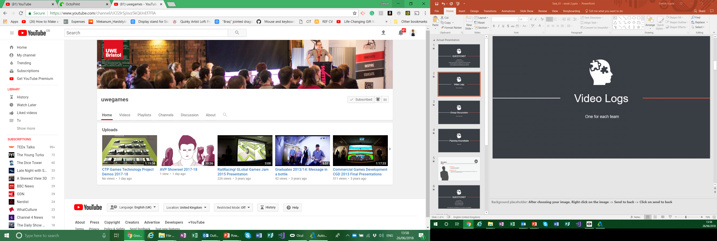
Video Logs
Place your screenshot here
Unlisted YouTube video.
I’ll add them to this years play list later!
If you think you made something pretty enough
+ TWEET + @UWEGamesMSc

Slide 7
DEMOS!
Place your screenshot here

Slide 8

One-On-One Meetings

Slide 9
Any questions?

